Slide 1

Mobile Application Development, Fall 2021 Advanced State Management Part 1

Slide 2
Today’s Agenda
The New Plan
Issues with Data
Getting Started with Providers and Context
Moving Data With Context
Adding in Some State

Slide 3
The New Plan
Congratulations! We’ve finished our first app!
The days of being a restaurant mogul are behind us! For now at least!
Now we move on to the next one: A Blog App!

Slide 4


The New Plan
Will have four screens: Index, Show, Create, and Edit
Index
Show
Create
Edit
Blog List
+
Blog List
Blog List
Blog List
Blog Title
Blog Title
My blog post today is going to be about my favorite things. Rain drops on roses and whiskers on Kittens!
Enter Title:
Enter New Title:
Blog Title
Blog Title
Enter Content:
Enter New Content:
Blog Title
Save
Save

Slide 5
The New Plan
Index shows a list of all blog posts, lets you delete them, and lets you add new ones!
Index
Show
Create
Edit
Blog List
+
Blog List
Blog List
Blog List
Blog Title
Blog Title
My blog post today is going to be about my favorite things. Rain drops on roses and whiskers on Kittens!
Enter Title:
Enter New Title:
Blog Title
Blog Title
Enter Content:
Enter New Content:
Blog Title
Save
Save

Slide 6
The New Plan
Show displays full information about a single blog post.
Index
Show
Create
Edit
Blog List
+
Blog List
Blog List
Blog List
Blog Title
Blog Title
My blog post today is going to be about my favorite things. Rain drops on roses and whiskers on Kittens!
Enter Title:
Enter New Title:
Blog Title
Blog Title
Enter Content:
Enter New Content:
Blog Title
Save
Save

Slide 7
The New Plan
Create and Edit are very similar – one creates a brand new blog post, the other alters an existing blog post.
Index
Show
Create
Edit
Blog List
+
Blog List
Blog List
Blog List
Blog Title
Blog Title
My blog post today is going to be about my favorite things. Rain drops on roses and whiskers on Kittens!
Enter Title:
Enter New Title:
Blog Title
Blog Title
Enter Content:
Enter New Content:
Blog Title
Save
Save

Slide 8
The New Plan
Maybe some of you have heard of CRUD before?
Create, Read, Update, Delete?
Common way of dealing with data, this app highlights all of that front and center!
Index
Show
Create
Edit
Blog List
+
Blog List
Blog List
Blog List
Blog Title
Blog Title
My blog post today is going to be about my favorite things. Rain drops on roses and whiskers on Kittens!
Enter Title:
Enter New Title:
Blog Title
Blog Title
Enter Content:
Enter New Content:
Blog Title
Save
Save

Slide 9
The New Plan
Going to learn a lot about data management! But goal is to keep it simple!
LOTS of time is going to be spent on how data is flowing through application
You’ll find we are significantly LESS concerned about styling!

Slide 10
The New Plan
OK, with that under our belt… it’s time to generate a new project!
Create a new project with
npx expo-cli init blog –-npm –-template blank –-name Blog

Slide 11
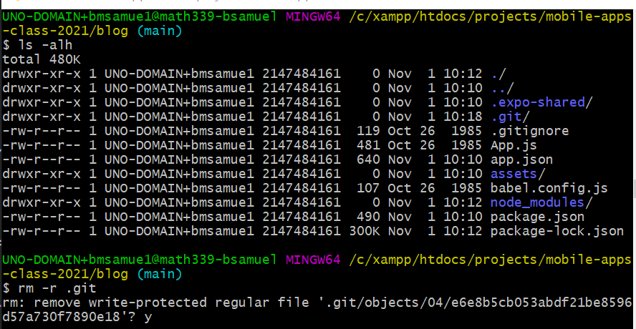
The New Plan
And if you use git…
You may then also want to cd into the new directory
cd blog
And then git rid of the git files that making the new project creates for you automatically
rm –r .git
And then type ‘y’ to a bunch of questions it asks you

Slide 12
The New Plan
Maybe this goes without saying, but a word to the wise:
CLOSE OUT of the Metro bundler before doing this.
If you have it running already, exit out of it on the terminal with CTRL-c.
Otherwise it won’t actually work, and you’ll be confused for a long time wondering why it didn’t install properly.

Slide 13
The New Plan
Also install react-navigation package right away.
From inside your new blog directory…
npm install react-navigation
It’s how we show different screens to our users!

Slide 14
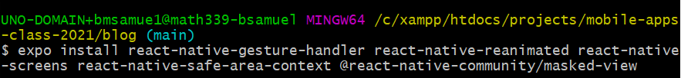
The New Plan
And there are some more navigation steps as well…
We install dependencies:
expo install react-native-gesture-handler react-native-reanimated react-native-screens react-native-safe-area-context @react-native-community/masked-view

Slide 15
The New Plan
And we specifically install stack navigation…
npm install react-navigation-stack @react-native-community/masked-view

Slide 16
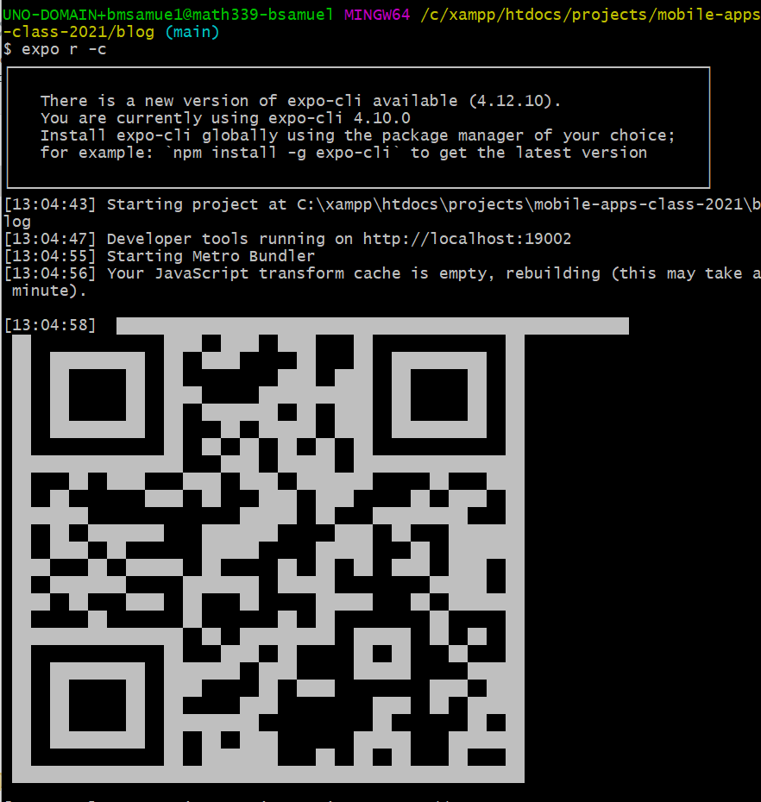
The New Plan
And then the first time, it is recommended that you start the app and clear the cache with
expo r –c
Though after this, the traditional “npm start” should be just fine.

Slide 17
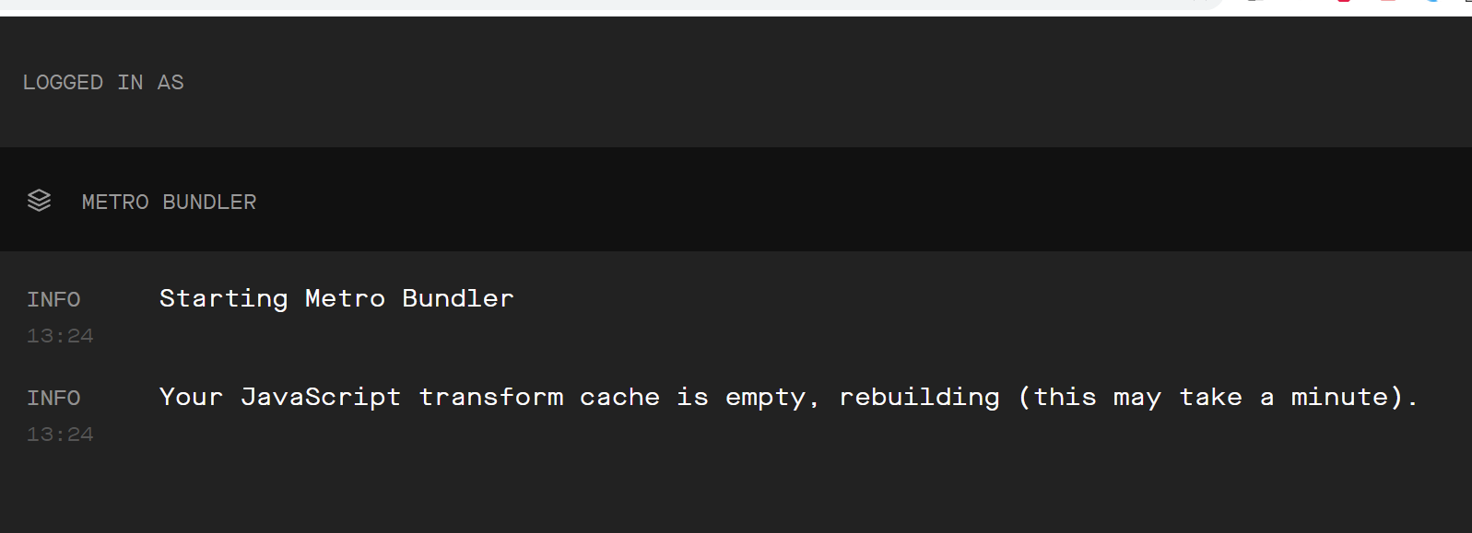
The New Plan
I found that to make the cleared cache actually get rebuilt, I had to close my browser tab that had the Metro Bundler and re-open it again.
But as you may recall from last time: this screen doesn’t do a satisfying job of ever providing feedback.

Slide 18
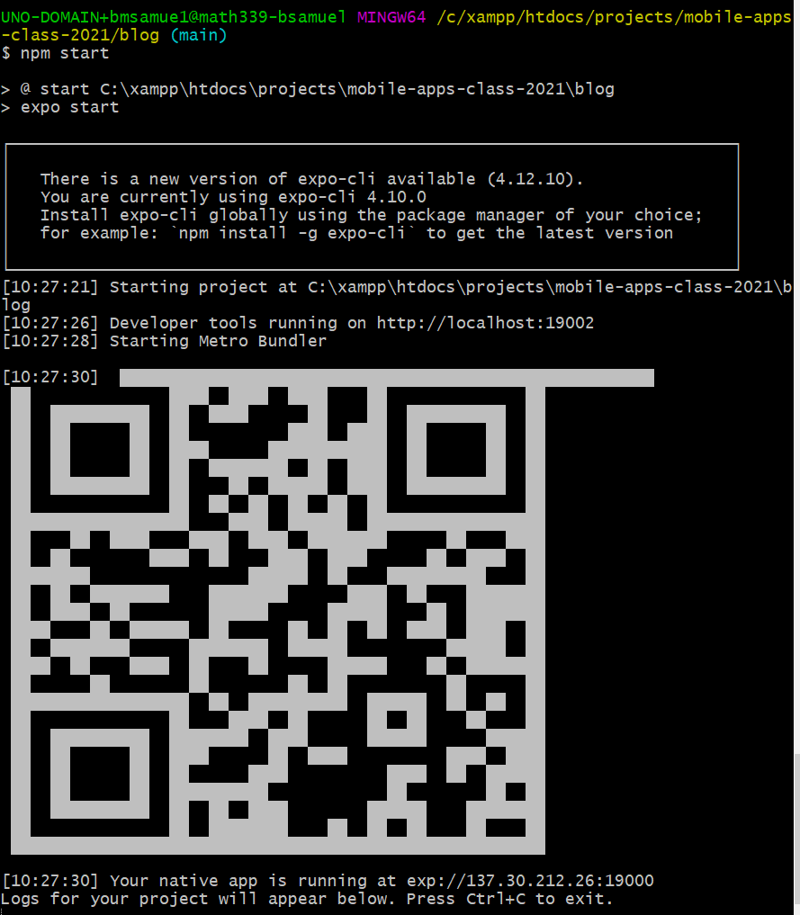
The New Plan
Anyway, by this point you should have a new project, with that QR code up and running!
I find that when starting a new project, it always asks me to upgrade – keep your eyes peels on the console to see if you need to do so too!
(Like, you might even need to manually re-install Expo on your device/emulator. It is kind of a pain).

Slide 19
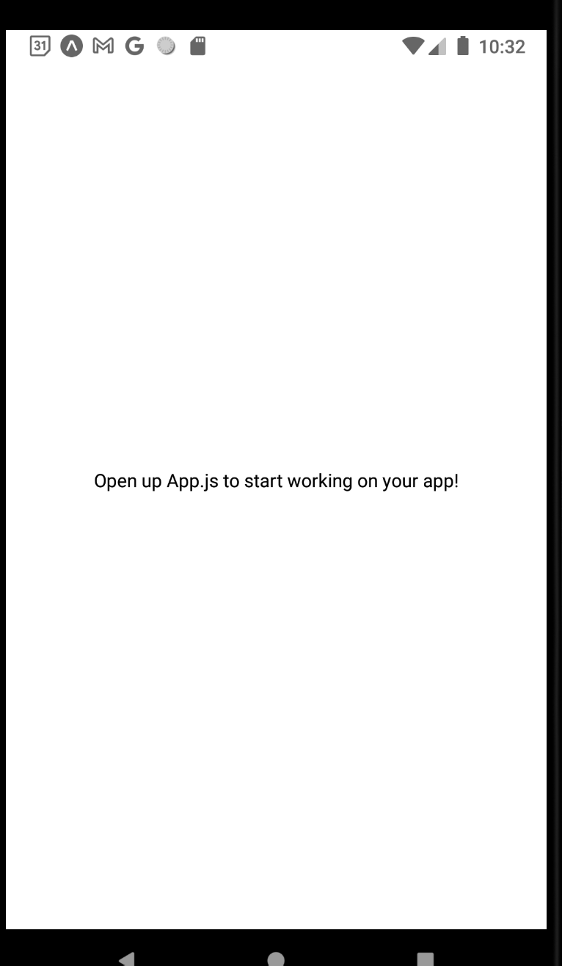
The New Plan
Anyway, after updating and re-installing expo on your device, once you actually get it up and running, you should see this old friend

Slide 20
Today’s Agenda
The New Plan
Issues with Data
Getting Started with Providers and Context
Moving Data With Context
Adding in Some State

Slide 21
Issues with Data
Let’s take some time thinking about some “big things” about this application.
Index
Show
Create
Edit
Blog List
+
Blog List
Blog List
Blog List
Blog Title
Blog Title
My blog post today is going to be about my favorite things. Rain drops on roses and whiskers on Kittens!
Enter Title:
Enter New Title:
Blog Title
Blog Title
Enter Content:
Enter New Content:
Blog Title
Save
Save

Slide 22
Issues with Data
Four screens: Listing all, Showing One, Creating One, Editing One.
Index
Show
Create
Edit
Blog List
+
Blog List
Blog List
Blog List
Blog Title
Blog Title
My blog post today is going to be about my favorite things. Rain drops on roses and whiskers on Kittens!
Enter Title:
Enter New Title:
Blog Title
Blog Title
Enter Content:
Enter New Content:
Blog Title
Save
Save

Slide 23
Issues with Data
All will be shown via stack navigation.
Index
Show
Create
Edit
Blog List
+
Blog List
Blog List
Blog List
Blog Title
Blog Title
My blog post today is going to be about my favorite things. Rain drops on roses and whiskers on Kittens!
Enter Title:
Enter New Title:
Blog Title
Blog Title
Enter Content:
Enter New Content:
Blog Title
Save
Save

Slide 24
Issues with Data
All will be shown via stack navigation.
React Navigation Stack Navigator
IndexScreen
ShowScreen
CreateScreen
EditScreen

Slide 25
Issues with Data
A big question: where should the blog posts exist?
We know we’ll need a list. But where should we store that?
React Navigation Stack Navigator
IndexScreen
ShowScreen
CreateScreen
EditScreen

Slide 26
Issues with Data
Maybe store it IndexScreen, and then we pass callback functions around to other screens?
We’ve done stuff like that before!
React Navigation Stack Navigator
IndexScreen
ShowScreen
CreateScreen
EditScreen

Slide 27
Issues with Data
We *COULD* do that, but it would introduce coupling between the screens! And would make it really hard to ever change anything.
React Navigation Stack Navigator
IndexScreen
ShowScreen
CreateScreen
EditScreen

Slide 28
Issues with Data
Blog Post Provider
So instead, we’re going to do something *totally different* than what we’ve done before.
We’re going to make use of a Provider.
React Navigation Stack Navigator
IndexScreen
ShowScreen
CreateScreen
EditScreen

Slide 29
Issues with Data
This is another Component, but one that isn’t necessarily ever rendered to the screen.
Rather, it is responsible for just like, holding on to all of the data.
And kind of like… distributing it to everywhere…
Blog Post Provider
React Navigation Stack Navigator
IndexScreen
ShowScreen
CreateScreen
EditScreen

Slide 30
Issues with Data
Blog Post Provider
So if we begin to think further in the future, about how all of these screens are probably going to have lots of child components…
Like, probably the IndexScreen will have a BlogList or something, yeah?
React Navigation Stack Navigator
IndexScreen
ShowScreen
CreateScreen
EditScreen
BlogList

Slide 31
Issues with Data
Blog Post Provider
The Provider will be wired up to just pass that data down to that child component directly!
blogPost: []
React Navigation Stack Navigator
IndexScreen
ShowScreen
CreateScreen
EditScreen
BlogList

Slide 32
Issues with Data
Blog Post Provider
We’ll also make use callback functions!
Because we want these child components to not just read the state, but to update it too!
Such as being able to delete a post!
blogPost: [],
deletePost: () => {}
React Navigation Stack Navigator
IndexScreen
ShowScreen
CreateScreen
EditScreen
BlogList

Slide 33
Issues with Data
Blog Post Provider
FYI: having all of our data kept in this one central place is known as Global State Management.
blogPost: [],
deletePost: () => {}
React Navigation Stack Navigator
IndexScreen
ShowScreen
CreateScreen
EditScreen
BlogList

Slide 34
Issues with Data
Blog Post Provider
There’s a React Native library called Redux that is very popular that basically does this for us.
But we’re going to implement it from scratch ourselves!
Basically!
blogPost: [],
deletePost: () => {}
React Navigation Stack Navigator
IndexScreen
ShowScreen
CreateScreen
EditScreen
BlogList

Slide 35
Today’s Agenda
The New Plan
Issues with Data
Getting Started with Providers and Context
Moving Data With Context
Adding in Some State

Slide 36
Getting Started
Blog Post Provider
So, clearly we’ve got our work cut out for ourselves!
There’s a lot here!
blogPost: [],
deletePost: () => {}
React Navigation Stack Navigator
IndexScreen
ShowScreen
CreateScreen
EditScreen
BlogList

Slide 37
Getting Started
But the journey of a thousand miles begins with a single step.
Let’s just focus on one screen for starters!
React Navigation Stack Navigator
IndexScreen

Slide 38
Getting Started
Blog Post Provider
And then we’ll spend some time getting to know how the Provider works!
Just FYI: we’re going to making a lot of “first pass” at things…
And then coming back later to make them nicer.
React Navigation Stack Navigator
IndexScreen

Slide 39
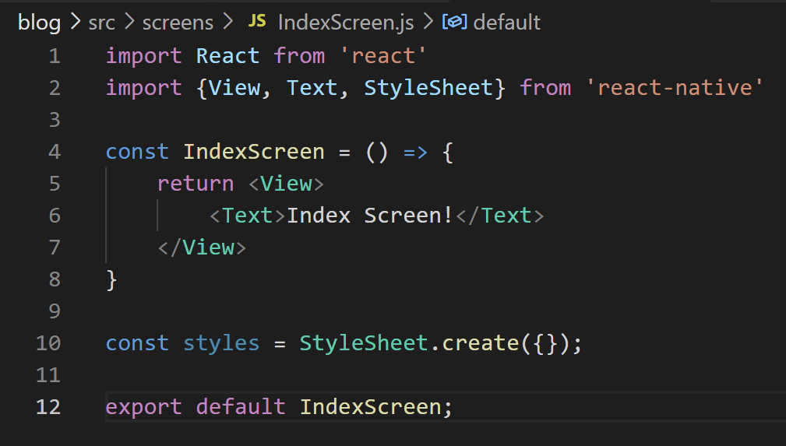
Getting Started
Things to do:
Make a new src directory
Make a screens directory inside of
Create boiler plate code for IndexScreen.js

Slide 40
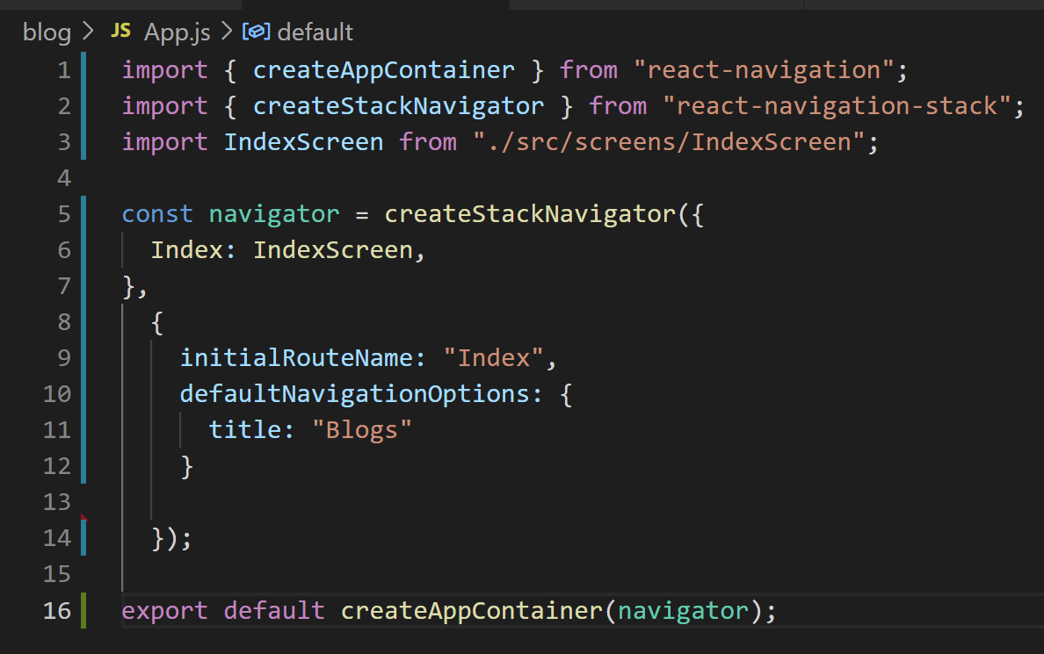
Getting Started
Things to do:
Get rid of all of the default App.js code.
Make our App.js screen “look like” our previous ones!
import createStackNavigator and createAppContainer
Actually create our stack navigator.
Export the component that createAppContainer returns.

Slide 41
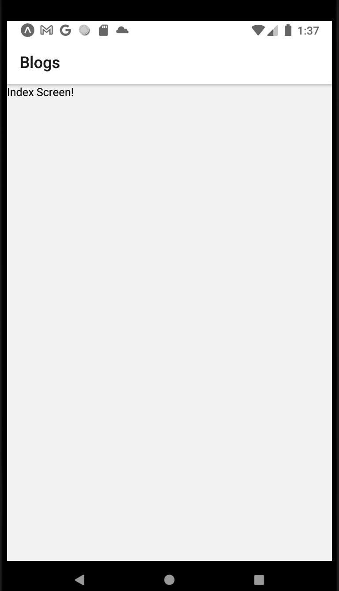
Getting Started
NOTE: This is the moment when you actually get confirmation that you set up React Navigation correctly.
*I* didn’t, it turned out (I didn’t quit out of the previous instance of the Metro Bundler) and it screwed everything up.
Anyway, in theory, you should get something like this!

Slide 42
Getting Started
Blog Post Provider
Great!
Now, let’s spend some time getting to understand what, exactly, a Provider is.
We see that, eventually, it’s gonna like, wrap our whole app.
React Navigation Stack Navigator
IndexScreen

Slide 43
Getting Started
Blog Post Provider
For starters, we’ll JUST worry about the wrapping.
We’ll come back to it and tinker it with a lot moving forward.
And like… any thoughts on this? When we say “wrapping our whole app up” does that like… ring any bells?
React Navigation Stack Navigator
IndexScreen

Slide 44
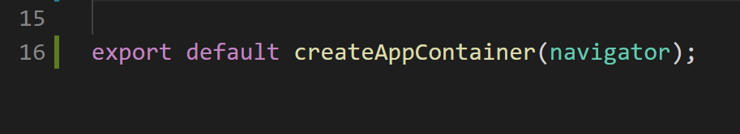
Getting Started
Blog Post Provider
We’re kind of doing it already at the Navigator level, right, in App.js?
Inside of App.js, that createAppContainer function returns a component…
And that component essentially *is* the stack navigator
Which has references to all of the other screens of our app.
React Navigation Stack Navigator
IndexScreen

Slide 45
Getting Started
Blog Post Provider
But what if, instead of just exporting that component right away…
We instead just stored it in a variable?
That code snippet above does just that.
App now holds the Component outlined in the dashed lines.
React Navigation Stack Navigator
IndexScreen

Slide 46
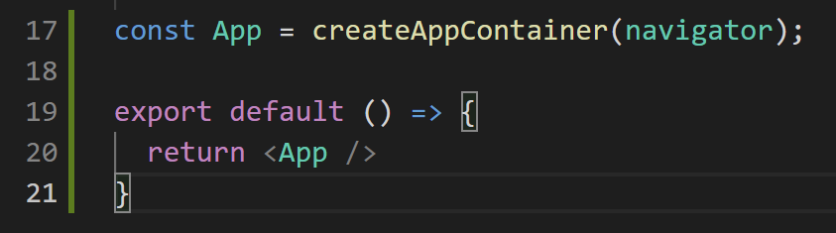
Getting Started
Blog Post Provider
We still want to export SOMETHING though.
So let’s do that! Let’s export a functional component like always!
Here a functional component with very simple JSX – it’s simply our App component!
React Navigation Stack Navigator
IndexScreen

Slide 47
Getting Started
Blog Post Provider
So the relationship is kind of like this now!
We have this outer (red) component that can have LOTS of things…
Right now it only has one thing, the inner (blue) component.
But in the future, we’ll be able to add lots more stuff to this!
React Navigation Stack Navigator
IndexScreen

Slide 48
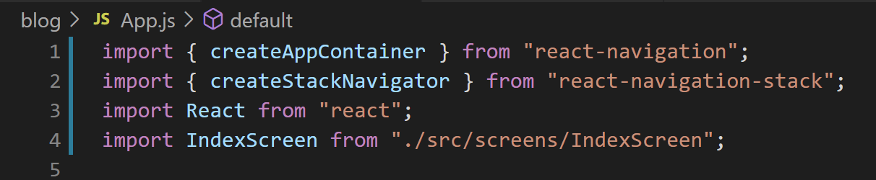

Getting Started
One quick bookkeeping thing…
Before, our App.js didn’t have JSX.
Now it does!
That means we need to import React from “react” inside of App.js
Otherwise it won’t know how to convert JSX to “normal” JavaScript.

Slide 49

Getting Started
One quick bookkeeping thing…
Before, our App.js didn’t have JSX.
Now it does!
That means we need to import React from “react” inside of App.js
Otherwise it won’t know how to convert JSX to “normal” JavaScript.

Slide 50
Getting Started
Blog Post Provider
React Navigation Stack Navigator
IndexScreen
ShowScreen
CreateScreen
EditScreen
BlogList
OK, that was a small change, but it’s now going to set us up to actually be able to create this Provider.
Whose tendrils will reach throughout our entire App.

Slide 51
Getting Started
In order for this to happen, we’re going to have to learn about a new React Native system.
That is…
We’ve worked with state…
We’ve worked with layouts….
We’ve worked with props...
Today, we introduce the system of Context

Slide 52
Getting Started
Context can be compared most easily against the Props system.
Communicates information down from a parent directly to a child
Props
Easy to Setup
To communicate data down multiple layers, we have to write a lot of code
Moves information from a parent to some nested child
Context
Complicated to setup. Involves lots of special terms.
Easy to communicate data from a parent to a deeply nested child.

Slide 53
Getting Started
Context can be compared most easily against the Props system.
Props
Generally easy… but passing data down deeply is a huge pain.
Context
A little more complicated… but GREAT at giving data to super nested children

Slide 54
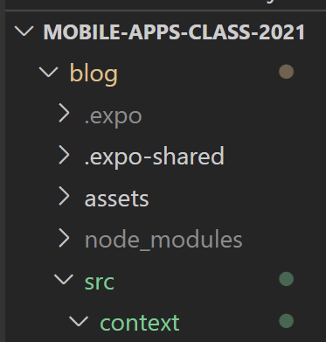
Getting Started
So let’s do it!
Let’s start working with Context!
Just like screens, and components, and hooks, and APIs…
This is another example of a “category” of thing…
That we’ll probably want to have in its own folder!
Called context of course
The though being that this provider we are about to make we’ll only have one of.
So it lives in a special place.

Slide 55
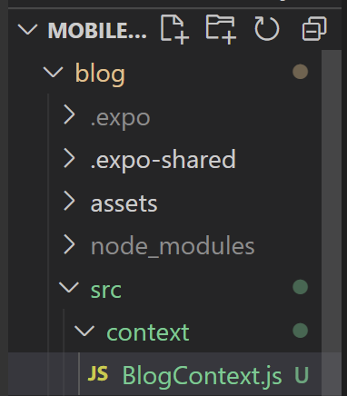
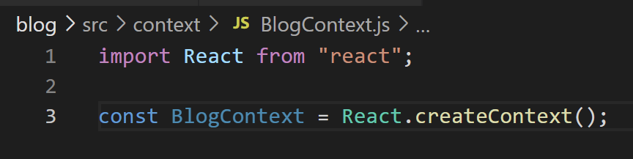
Getting Started
Inside of there, we’ll make a new .js file
BlogContext.js
And start it off with this code right here:

Slide 56
Getting Started
Here, we’re invoking the createContext() method from the React library.
It produces a “Context”, which we then store inside of this BlogContext variable.

Slide 57
Getting Started
Blog Post Provider
Eventually, that new variable we just made is basically going to be THIS red pipe.
It’s the thing that will let us shepherd information down to nested children.
As promised!
React Navigation Stack Navigator
IndexScreen
ShowScreen
CreateScreen
EditScreen
BlogList

Slide 58
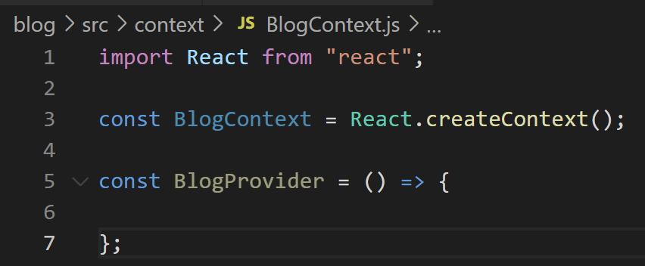
Getting Started
We’re now going to start the process of creating a new functional component in here called BlogProvider.
BlogContext.js

Slide 59


Getting Started
Blog Post Provider
Which is what is eventually going to be this thing in our little diagram!
React Navigation Stack Navigator
IndexScreen
ShowScreen
CreateScreen
EditScreen
BlogList

Slide 60
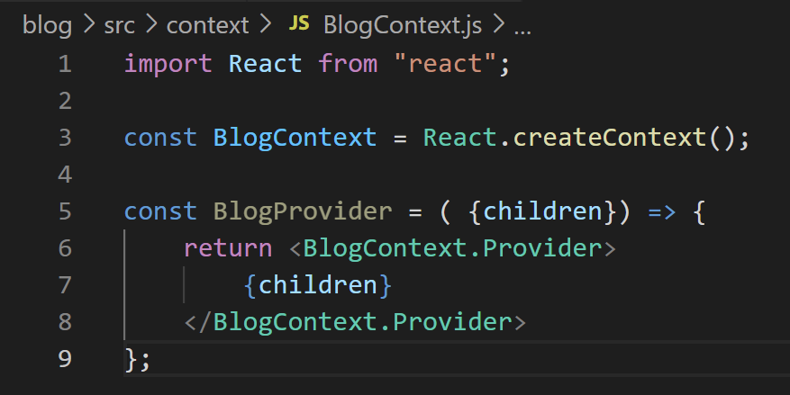
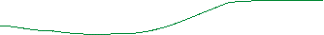

Getting Started
We’re going to flesh that out with a few things…
We’ll have it take in a (destructured) parameter called children.
We’ll have it return a <BlogContext.Provider> component.
And inside of that component, we’ll specify that children argument.

Slide 61
Getting Started
This probably immediately raises the questions…
WHAT is {children} ????
WHAT is <BlogContext.Provider> ???

Slide 62
Getting Started
Let’s start with {children}
One thing to note: it technically isn’t a “Context” thing – it’s just a React Native thing that we haven’t used yet.
But we’ll see why it will be useful for our Context purposes!

Slide 63
Getting Started
App
So, as it turns out, whenever we’ve had a situation like this, with nested components…
const App = () => {
return <CustomComponent>
<Text>Hi there!</Text>
</CustomComponent>
}
children: <Text>Hi there</Text>
CustomComponent

Slide 64


Getting Started
App
Here, we can see that <Text> is nested within our <CustomComponent> component…
const App = () => {
return <CustomComponent>
<Text>Hi there!</Text>
</CustomComponent>
}
children: <Text>Hi there</Text>
CustomComponent

Slide 65



Getting Started
App
It’s actually possible for that CustomComponent to *access* those nested components! They live inside of this “children” property.
const App = () => {
return <CustomComponent>
<Text>Hi there!</Text>
</CustomComponent>
}
children: <Text>Hi there</Text>
CustomComponent

Slide 66
Getting Started
So this is setting us up for future success!
Basically it is saying: BlogProvider is a component that might have “nested” components within it someday.
And if and when that happens, it can access them via this children parameter.
Which we’ll then basically just return within this <BlogContext.Provider> line.

Slide 67
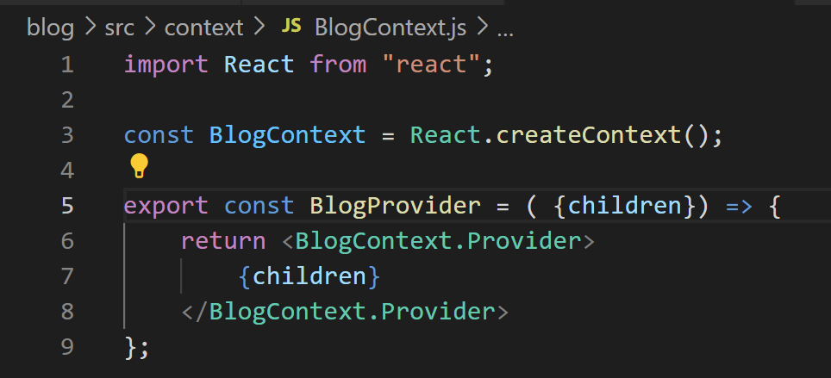
Getting Started
It will hopefully be made more clear once we see some examples!
One other thing: we’re going to export this component we just made.
WITHOUT the default keyword!
(We’ll be back and export default something else later).

Slide 68
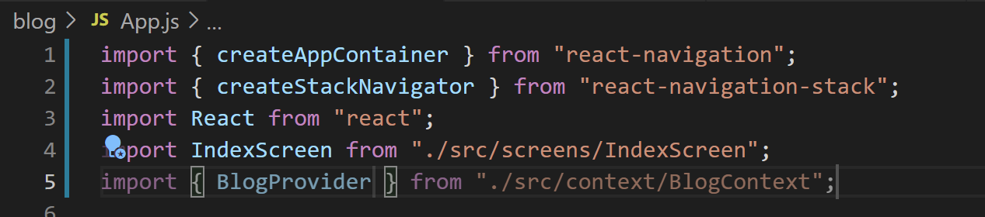
Getting Started
And then in App.js, we need to import the BlogProvider we just exported.
NOTE that we need to wrap it in curly braces!
That’s the difference between ‘export default’ and just ‘export’
When you just do ‘export’ it is called a “named export”
And you need to specify the specific name of the thing you are importing inside of curly braces.
Here, the thing we exported was BlogProvider, so we import it like the above.

Slide 69
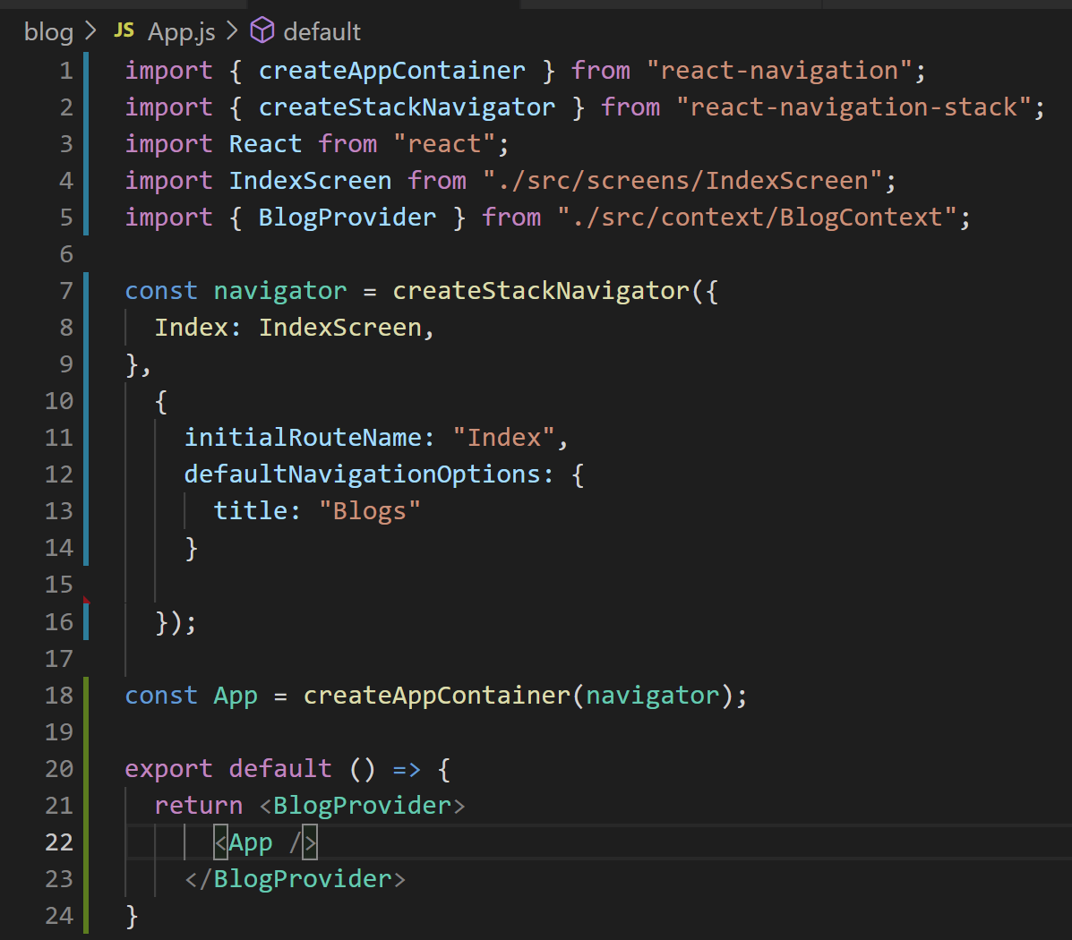
Getting Started
And now, we’ll make use of what we just imported!
We return this BlogProvider component we just made…
Nesting the App component inside of it.
Does the picture kind of become a little clearer now?

Slide 70
Getting Started
App is our “stack navigator”
App is our “normal application”

Slide 71
Getting Started
Blog Post Provider
App is everything encased in the black dashed line.
React Navigation Stack Navigator
IndexScreen

Slide 72
Getting Started
BlogProvider is another custom component that we just made…
That has App nested inside of it…

Slide 73
Getting Started
That will be able to ACCESS that App, via this children argument.

Slide 74
Getting Started
Blog Post Provider
i.e., it’s this wrapper part out here! It’s going to include everything!
App is going to be the “child” of Provider!
React Navigation Stack Navigator
IndexScreen

Slide 75
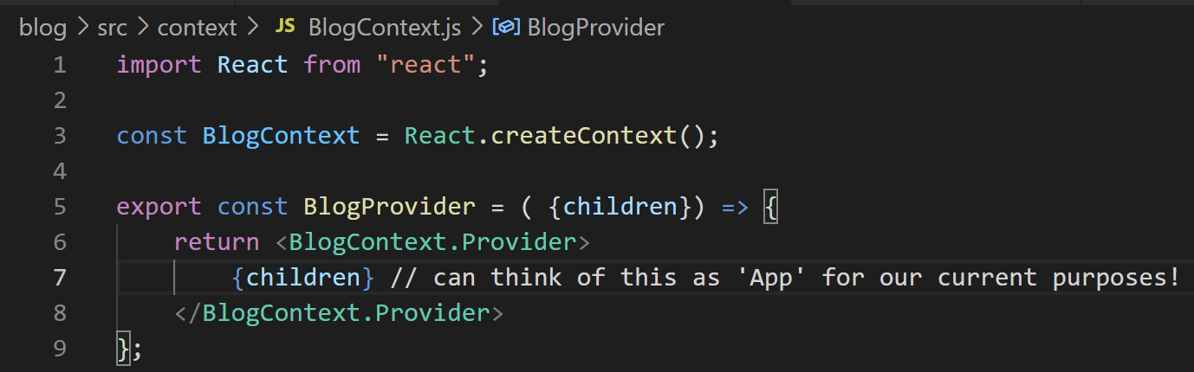
Getting Started
So in this current app, inside of BlogProvider, you could think of {children} as BEING App!

Slide 76
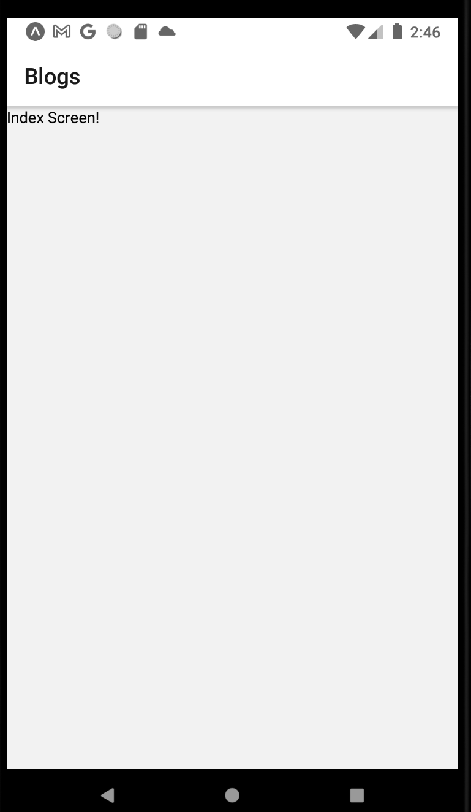
Getting Started
And like so many software engineering things…
None of that actually CHANGED our output at all!
But it’s going to set us up for success in passing data directly down into nested components down the line!

Slide 77
Today’s Agenda
The New Plan
Issues with Data
Getting Started with Providers and Context
Moving Data With Context
Styling it up!

Slide 78
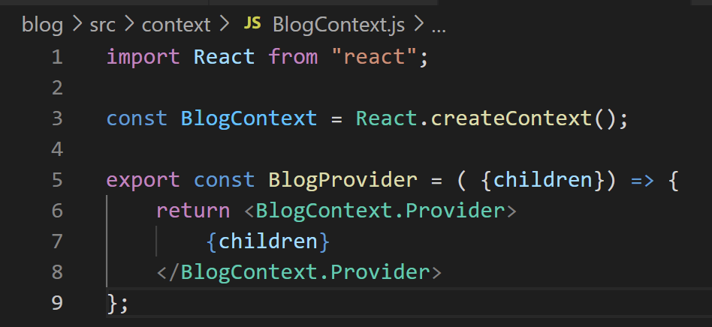
Moving Data With Context
OK, hopefully *some* things are feeling a *little* clearer.
But there’s still absolutely a lot of mystery at play.
What is / how do we use this BlogContext thing?
What does this BlogContext.Provider mean?

Slide 79
Moving Data With Context
So, first of all, this BlogContext is a Context Object.
We get Context Objects when we invoke that React.createContext() function.

Slide 80
Moving Data With Context
As we know, Objects can store many properties inside of them.
Context Objects are no exception.
One of the “things” inside of a Context Object is this .Provider property.

Slide 81
Moving Data With Context
The Provider is essentially going to be become this font of knowledge.
We are going to provide it with information that we want it to store.
And in turn, it will provide that information to all of the other components of our app.

Slide 82
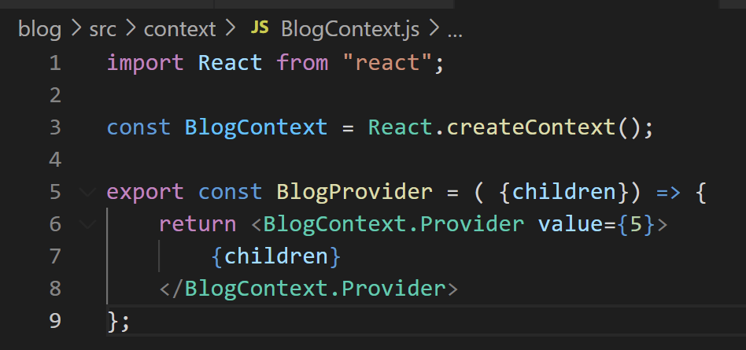
Moving Data With Context
Let’s kind of see it in action!
We just gave that BlogContext.Provider component a prop!
Its name is value!
That is important! The prop needs to be called value.
Its value is 5!
This is less important. Picked arbitrarily!
This is now a piece of information we’re providing the provider.

Slide 83
Moving Data With Context
Blog Post Provider
And again…
The idea is that we want the provider to able to PROVIDE information like this…
Directly down to deeply nested children.
React Navigation Stack Navigator
IndexScreen
ShowScreen
CreateScreen
EditScreen
BlogList

Slide 84
Moving Data With Context
Blog Post Provider
Basically: we are now going to have the means to allow any of these child components the capacity to reach into the Provider, and extract out that “value” prop.
React Navigation Stack Navigator
IndexScreen
ShowScreen
CreateScreen
EditScreen
BlogList

Slide 85
Moving Data With Context
Blog Post Provider
We mentioned a bit ago that this “line” is going to pipe the data from the provider to other components.
And that the BlogContext (i.e., the Context Object) we created IS that line.
React Navigation Stack Navigator
IndexScreen
ShowScreen
CreateScreen
EditScreen
BlogList

Slide 86
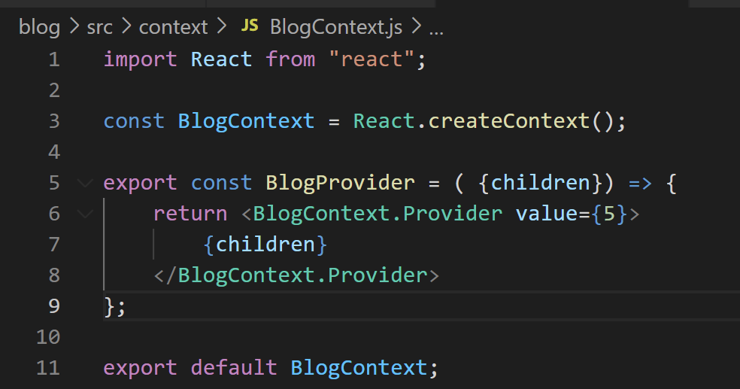

Moving Data With Context
So in order for other components of our code to make USE of that Context object, we need to export it.
So we’ll do that!
Note that this time we DID mark is as the default export.

Slide 87
Moving Data With Context
At the moment, we only have one other component. Our IndexScreen.js
But let’s see if it can access the data stored in our Provider!

Slide 88
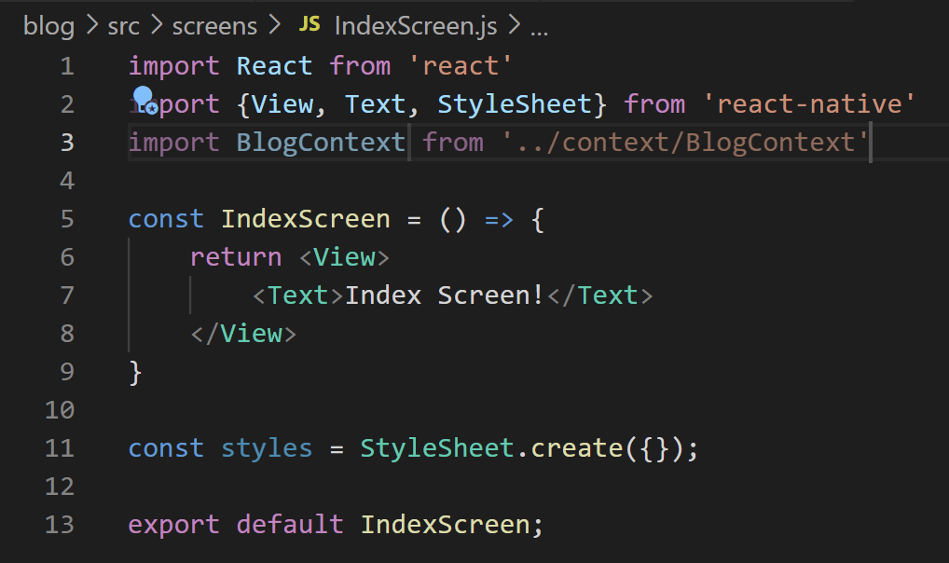
Moving Data With Context
SO… first we need to import that Context object we just exported.
We do that here!
Note how we DON’T need curly braces this time!
That’s because of the default keyword we used when exporting!
IndexScreen.js

Slide 89
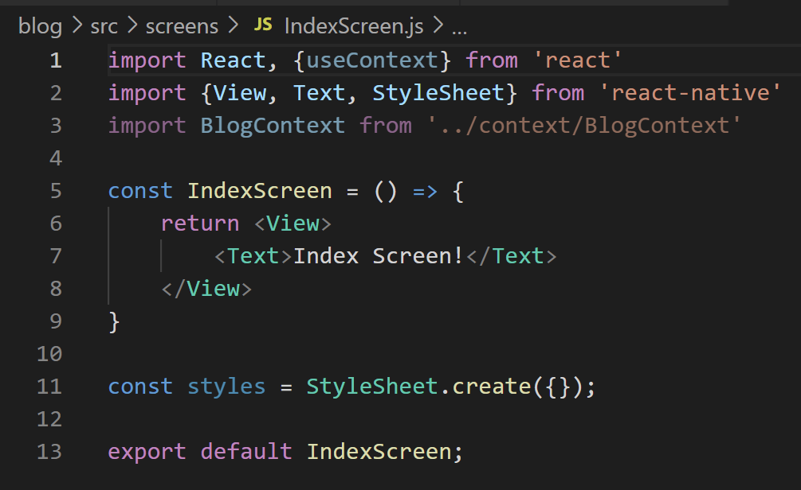
Moving Data With Context
However, in order to make use of this Context object, we need to make use of a NEW hook!
useContext
Remember: hooks as we’ve seen are just functions we import that give us additional functionality.
IndexScreen.js

Slide 90
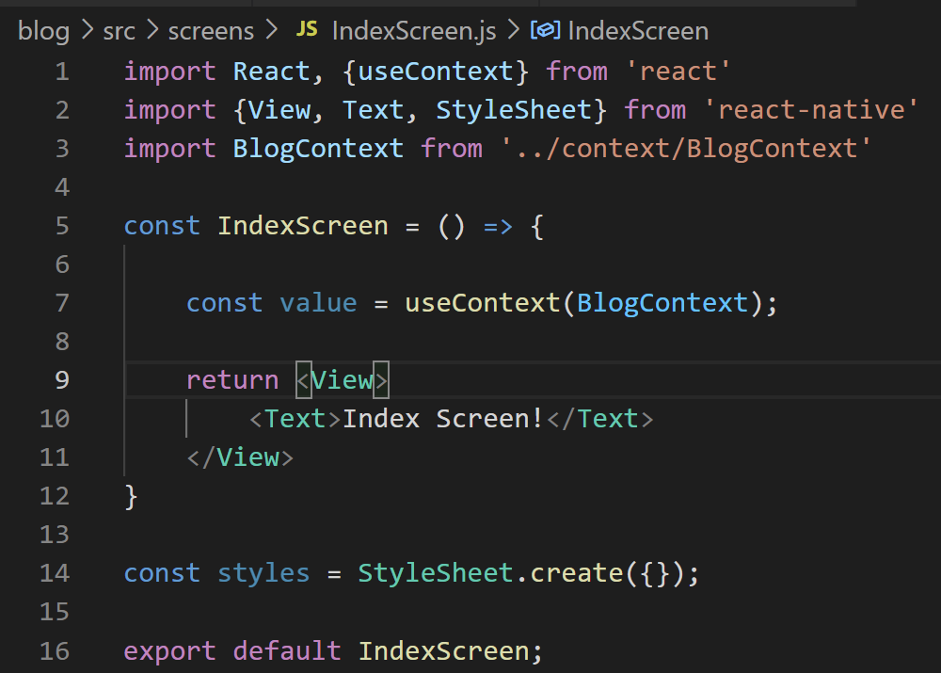
Moving Data With Context
The way that useContext() works is that we pass in a ContextObject…
And it gets us the data that it has inside of it!
IndexScreen.js

Slide 91
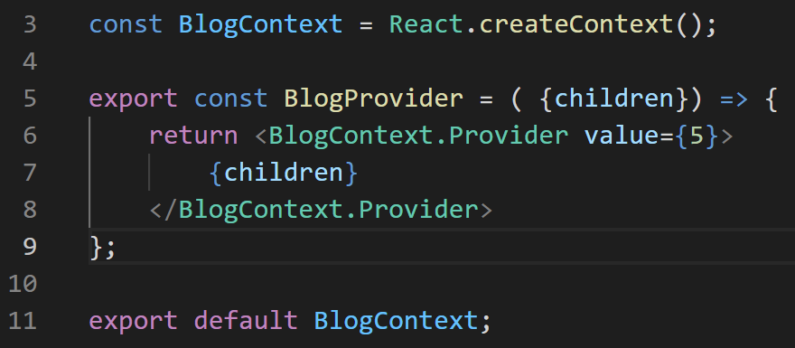
Moving Data With Context
I know that we’re throwing around a lot of new vocab here, but believe me, at the end of the day, the actual “data flow” at play is simple!
BlogContext.js
IndexScreen.js

Slide 92
Moving Data With Context
We create a Context object
Here called BlogContext.
That ContextObject has something called a Provider…
And we give that Provider a value prop that stores data. Here, just the number five.
BlogContext.js
IndexScreen.js

Slide 93
Moving Data With Context
Now that we have that, we can import that Context Object in other components.
And through the use of the useContext hook…
We can get access to the data that was stored in the Context’s Provider.
BlogContext.js
IndexScreen.js

Slide 94


Moving Data With Context
Or in even simpler terms:
We put the data INTO the Provider…
And then we get the data OUT OF the Provider.
That’s all that’s going on!
BlogContext.js
IndexScreen.js

Slide 95
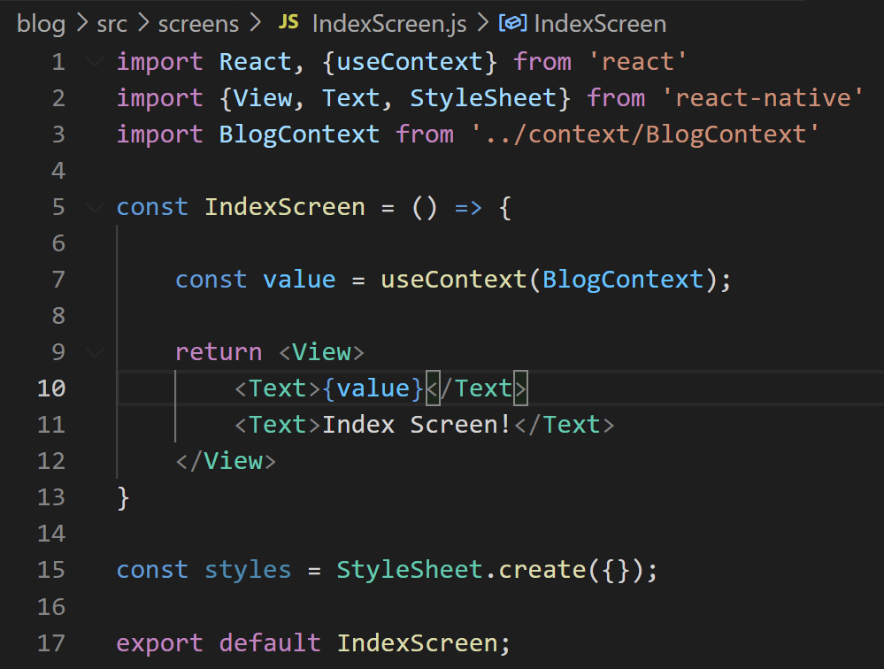
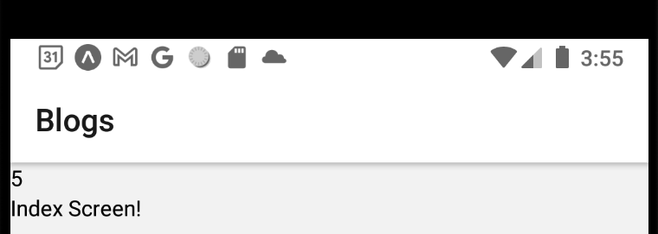

Moving Data With Context
And just to prove that it is, in fact, working…
If we print out the value that we got from the Context Object…
It does, indeed, say 5.
IndexScreen.js

Slide 96
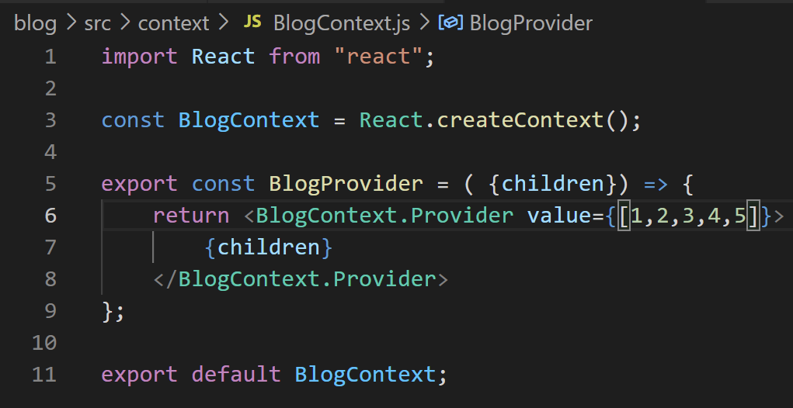
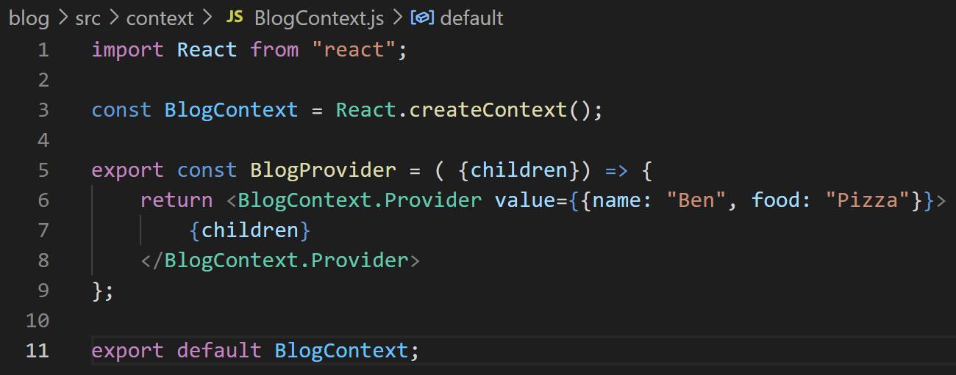


Moving Data With Context
And if instead of 5, we wanted something more complicated…
Like an [] of data…
Or an object…
We totally could have done all that too!
IndexScreen.js

Slide 97
Moving Data With Context
So let’s do that now! Let’s work on having the data be more complicated!
Namely: Let’s have it be a list of blog posts!
Or from a type-standpoint: a list of objects!
Where each object represents a blog post, of course!

Slide 98
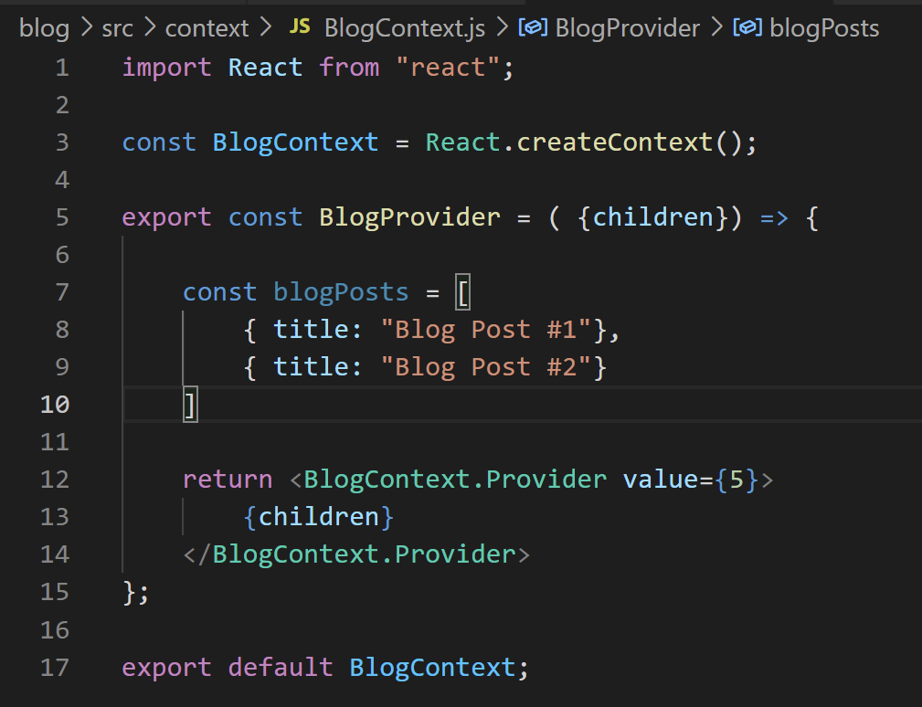

Moving Data With Context
First, we need to whip ourselves up some blog posts!
This is a good thing to be aware of when making apps: creating some dummy data!
Here we have an array with two objects.
And each object just has one property, “title”.

Slide 99
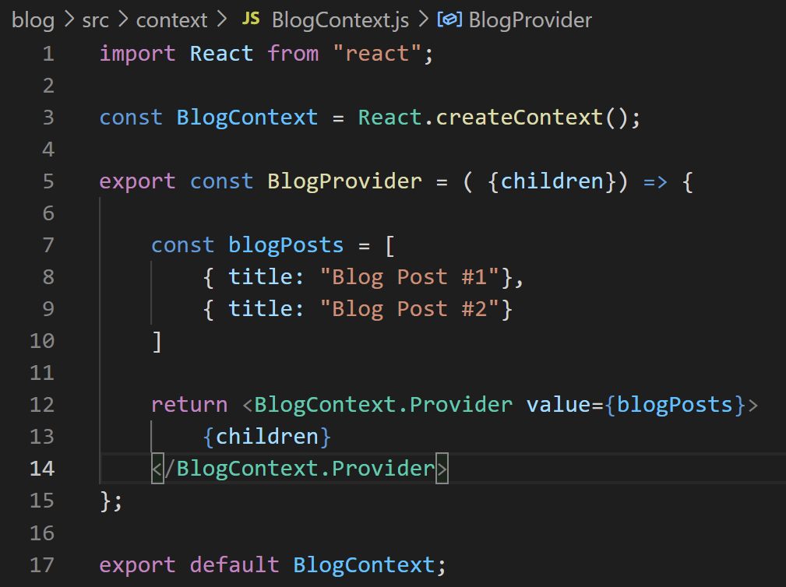
Moving Data With Context
We can then simply have that variable become the value of our Provider’s value!
AND WOW!
Now every screen will have access to this array of objects!

Slide 100
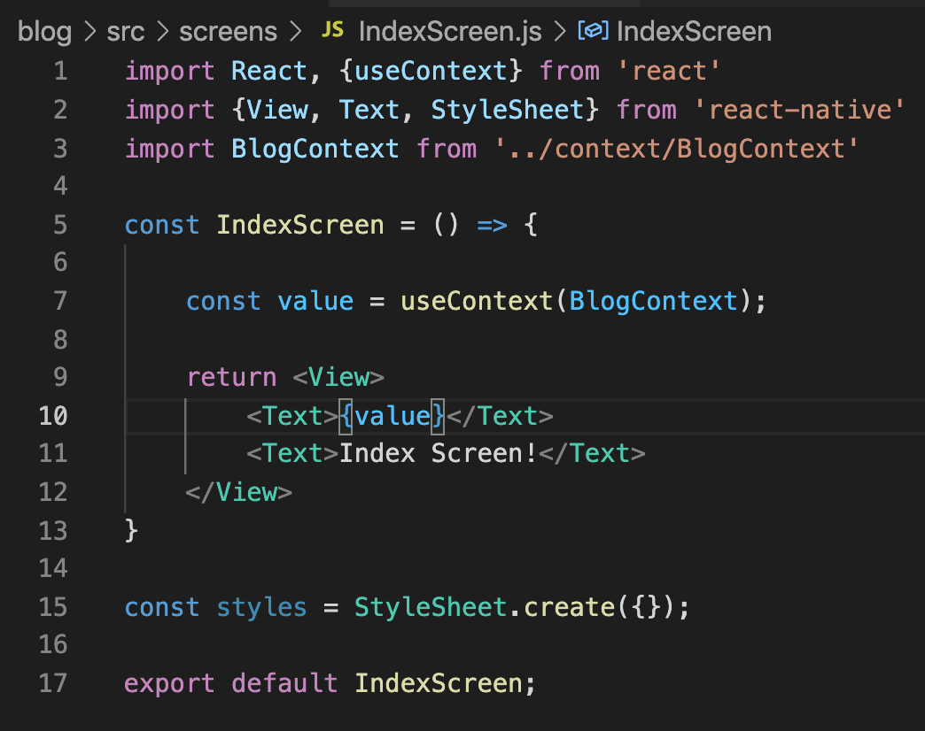
Moving Data With Context
And back in IndexScreen…
Now value is going to be holding on to that array of objects.
(And you’ll probably see an error message, since we are trying to display an Object inside of Text here).

Slide 101
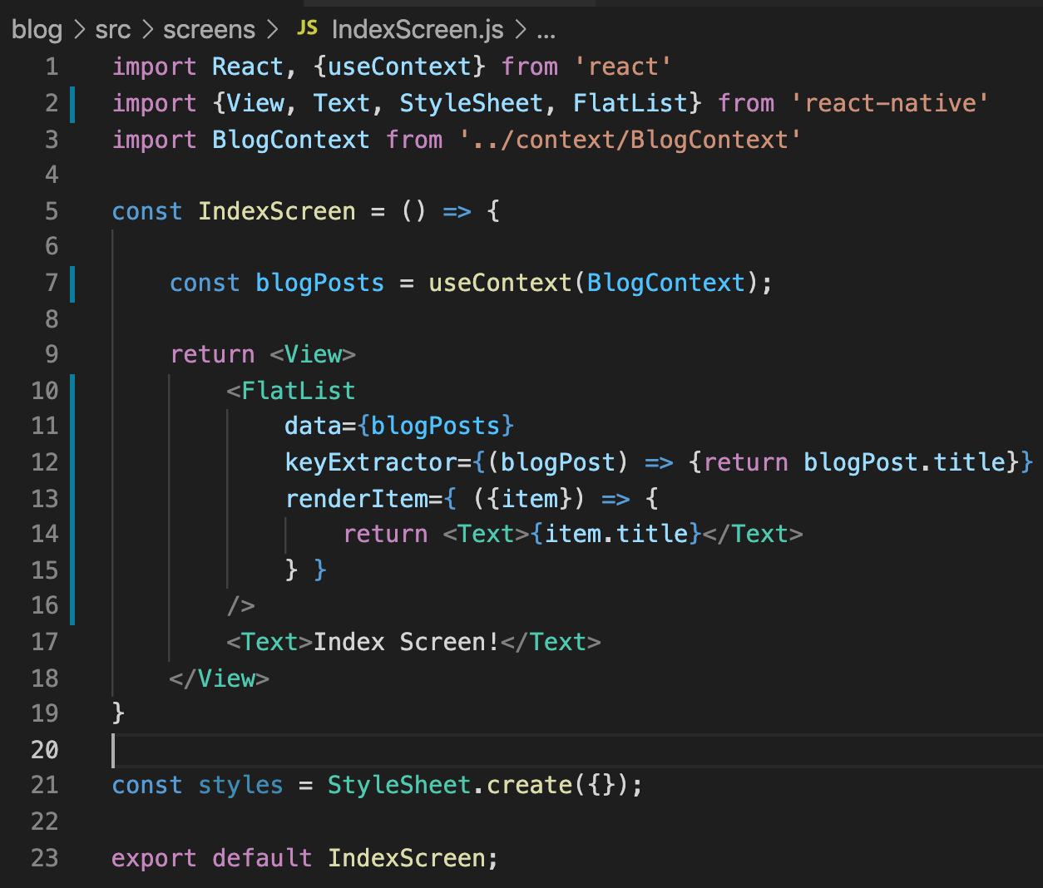
Moving Data With Context
Since we have an array of blog posts…
Let’s display them as a FlatList, our favorite!
By this point, this is pretty self explanatory?

Slide 102
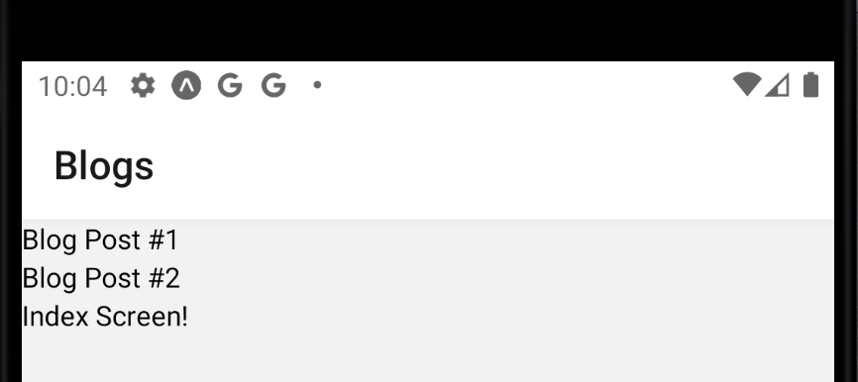
Moving Data With Context
And the result is what you would expect!
We have a list of blog posts!

Slide 103
Moving Data With Context
This is a good start!
But sure, reading from this data that is stored in the Provider is great and all…
BUT…
Wouldn’t it be excellent if we could edit it as well?
If these child components could add to, or remove from, the blog post list?
Let’s make that happen!!

Slide 104
Today’s Agenda
The New Plan
Issues with Data
Getting Started with Providers and Context
Moving Data With Context
Adding in Some State

Slide 105
Adding State
We want to be able to connect all this jazz with the state system!
For example, we want to be able to add or delete a blog post…
And for the screen to re-render, displaying the updated list immediately.
That should, I hope, immediately make your brain think of the React Native state system by this point!
i.e., “useReducer” and “useState”

Slide 106
Adding State
Blog Post Provider
blogPosts
React Navigation Stack Navigator
This diagram depicts what we have now…
The Blog Post Provider gives our list of blog posts directly to the IndexScreen
IndexScreen

Slide 107
Adding State
Blog Post Provider
{data: blogPosts
addBlogPost: () = {} }
blogPosts
React Navigation Stack Navigator
What we are essentially going to do, is declare our blogPosts to be state variables inside of blog post provider…
And then pass not only the blogPosts down, but also a callback function, to whatever child components we want.
The callback function being some mechanism to change the state, of course.
That way, the child components can then both read to and write from these state variables.
IndexScreen

Slide 108
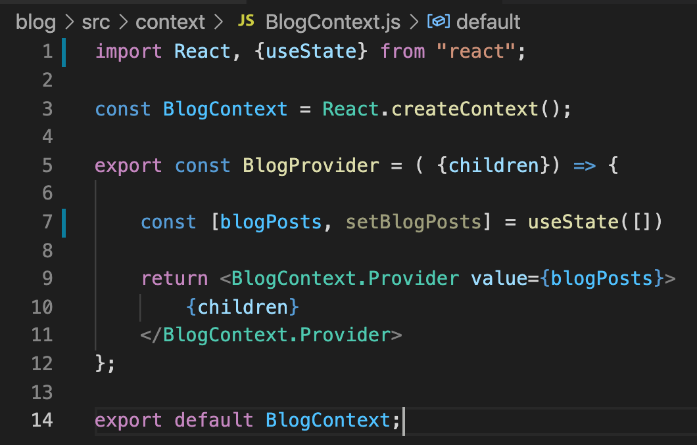
Adding State
There will be an opportunity for leveraging a reducer on this soon enough…
But let’s start off with useState.
So, in BlogContext, we are using useState to establish a state variable (blogPosts) that will be an array that starts off empty.

Slide 109
Adding State
Of course, the setter that we got back basically creates an entirely *new* array…
But if we are concerned about *adding* a new element to the array, it doesn’t have to be from scratch.
We want to just add to the existing array in that case.

Slide 110
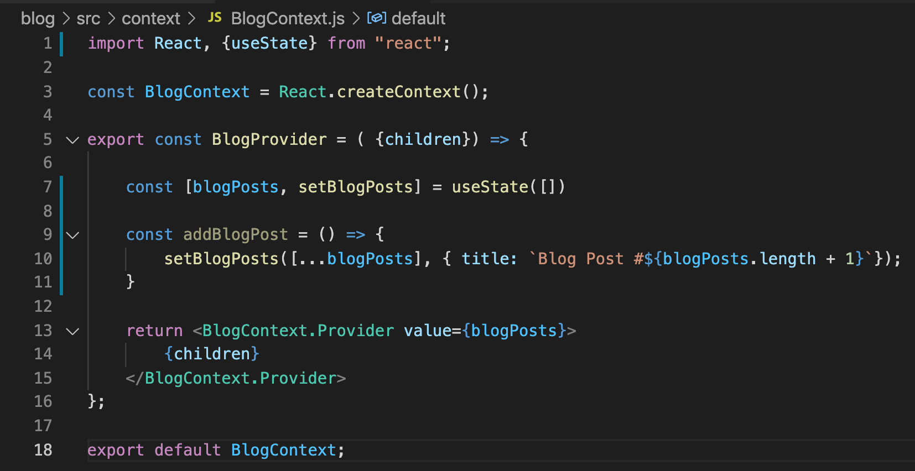
Adding State
We can create a nice little helper function too help us out with this…
The helper function is addBlogPost

Slide 111
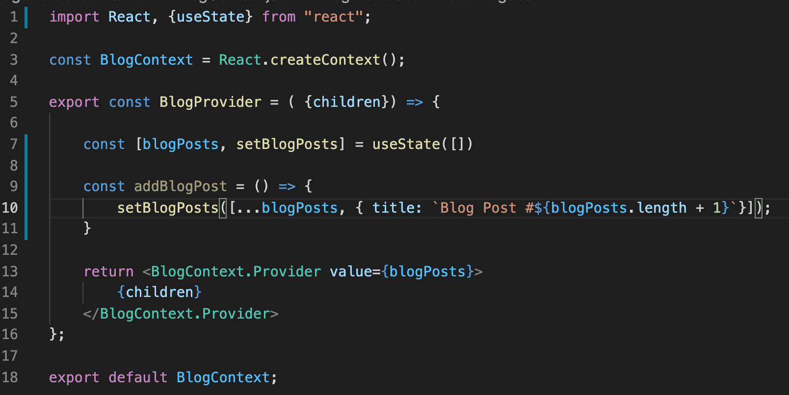
Adding State
It calls setBlogPosts still… so it does create an entirely new array…
But the first thing we do is copy over all of the old blog posts into this new array with the … syntax
And then we add in a new entry.

Slide 112
Adding State
Specifically, our new entry is an object where we automatically determine which number it is, based on the current length of the array!
Note the string templating!

Slide 113

Adding State
So, great, we’ve made this nice little helper function!
But we need to now include this in the provider, so that other files in our code can use and access it.
We need too make our value object more involved here!

Slide 114
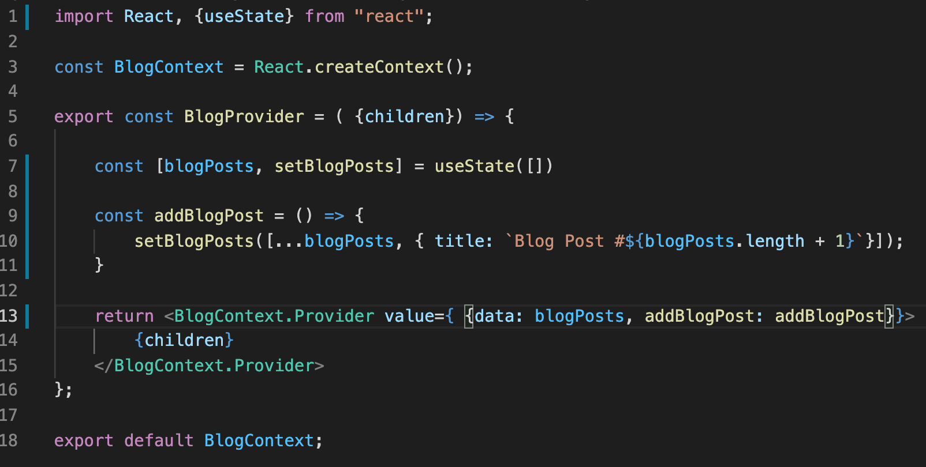
Adding State
Perhaps it will look something like this!
Where we pass in an object to value (note the inner { } -- that means object as we know!)
And we give it two properties
The blog posts themselves, stored in data.
And the function to add a new blog post, stored in addBlogPost.

Slide 115
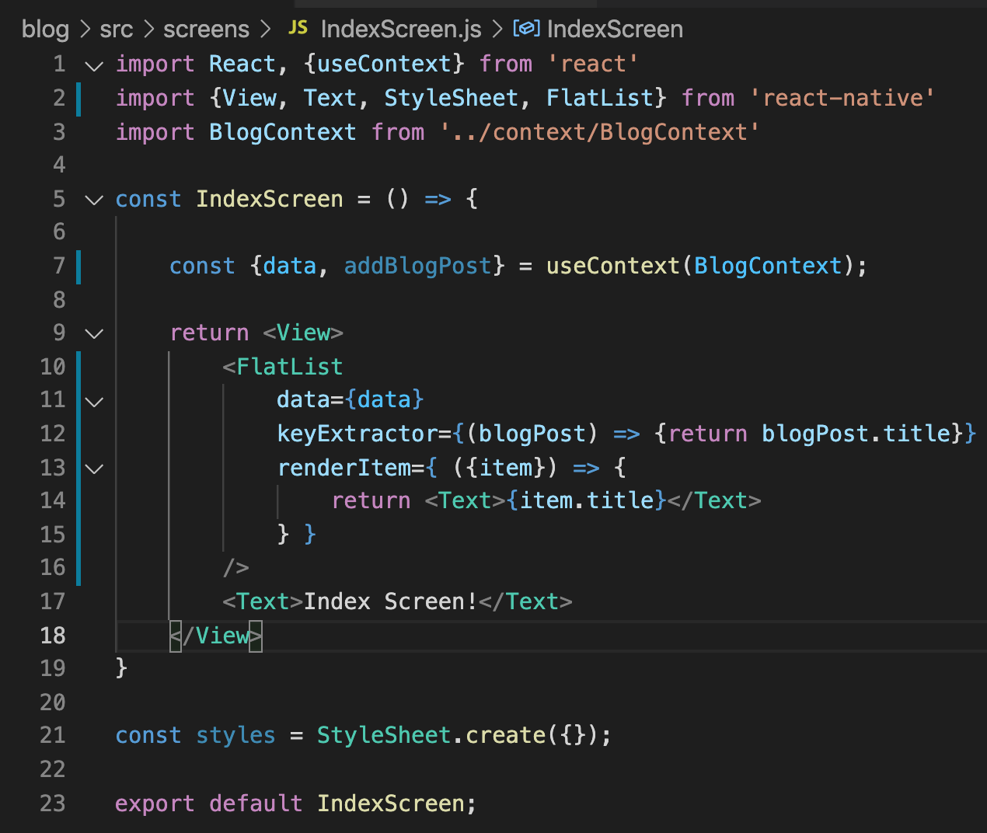

Adding State
Now we need to make use of this inside of our IndexScreen.
Note that we are now retrieving an object from our Context Object.
And destructuring its properties to live in two variables.
I also already updated our FlatList data prop.

Slide 116
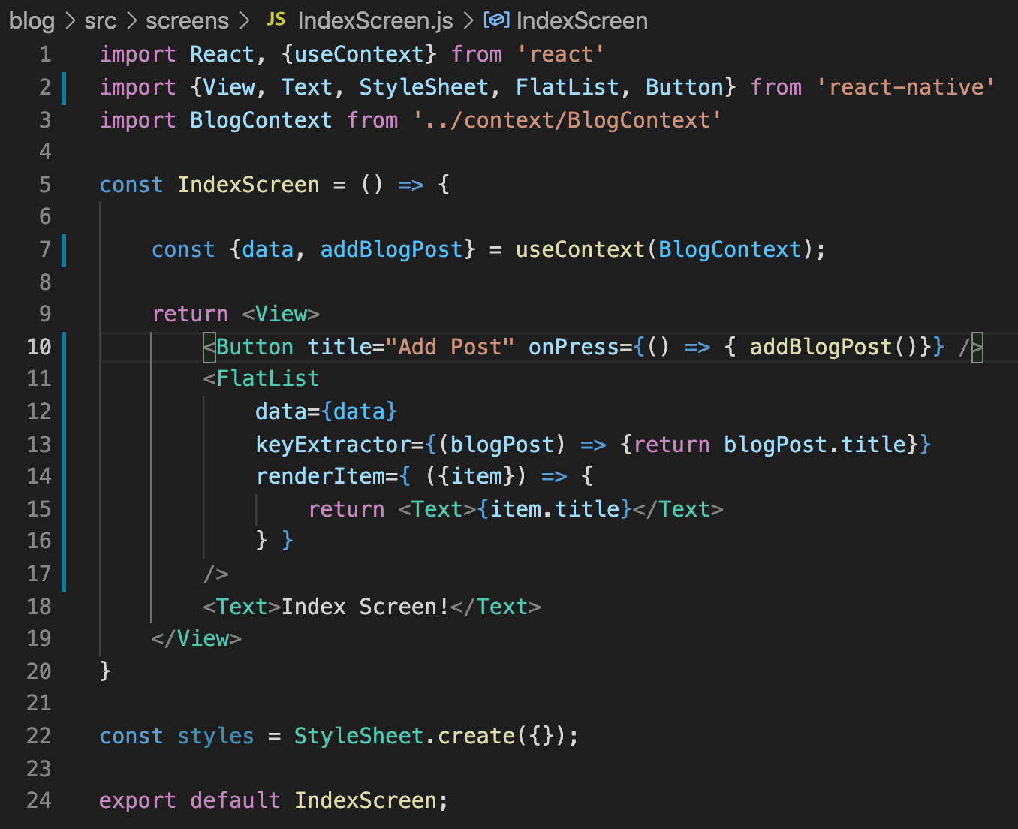
Adding State
And so, let’s say we wanted to make it so that a new blog post is added upon a Button press…
Well, it might look something like this!
We just add a new button, and have its onPress event be the function we just passed down through our Provider.

Slide 117
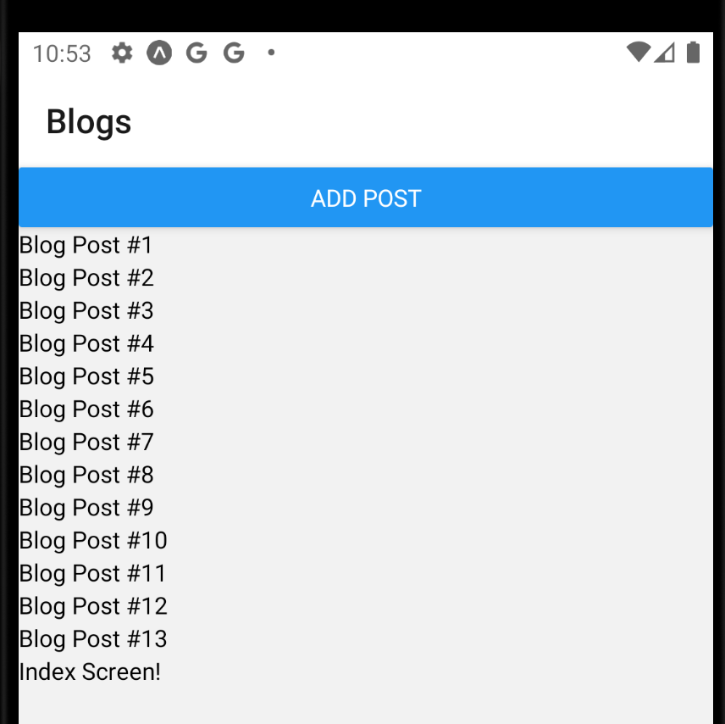
Adding State
And indeed, it works!

Slide 118
Adding State
Very cool!
Now, you might hear people conflate “Context” and “State”
They’ll say “Oh, I’m using Context to manage State”
And like… as we just saw, its understandable why some people would say that…
BUT! Technically speaking, Context is just about the flow of data. Its about moving information!
State is its own system, that makes the screen re-render whenever the state changes.

